Slide 1

CampusEYE — AI-Based Classroom Photo Attendance
Automated, privacy-conscious attendance using classroom photos and state-of-the-art face recognition. Designed for university IT admins, faculty stakeholders, and engineering teams.

Slide 2

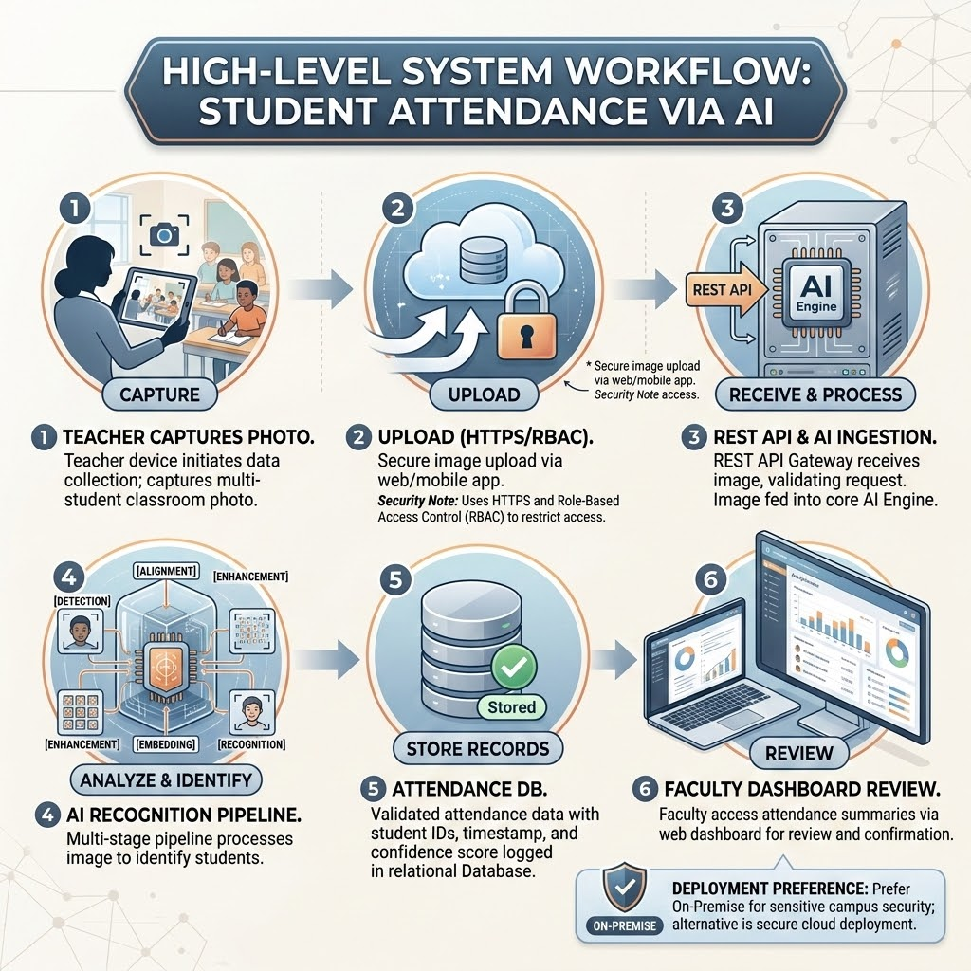

High-level System Workflow
Teacher captures photo → uploads via web/mobile app → REST API receives image → AI engine performs detection, alignment, enhancement, embedding, and recognition → attendance stored in DB → faculty reviews via dashboard.
Use HTTPS and role-based access for uploads; prefer on-premise deployment for sensitive campuses.

Slide 3
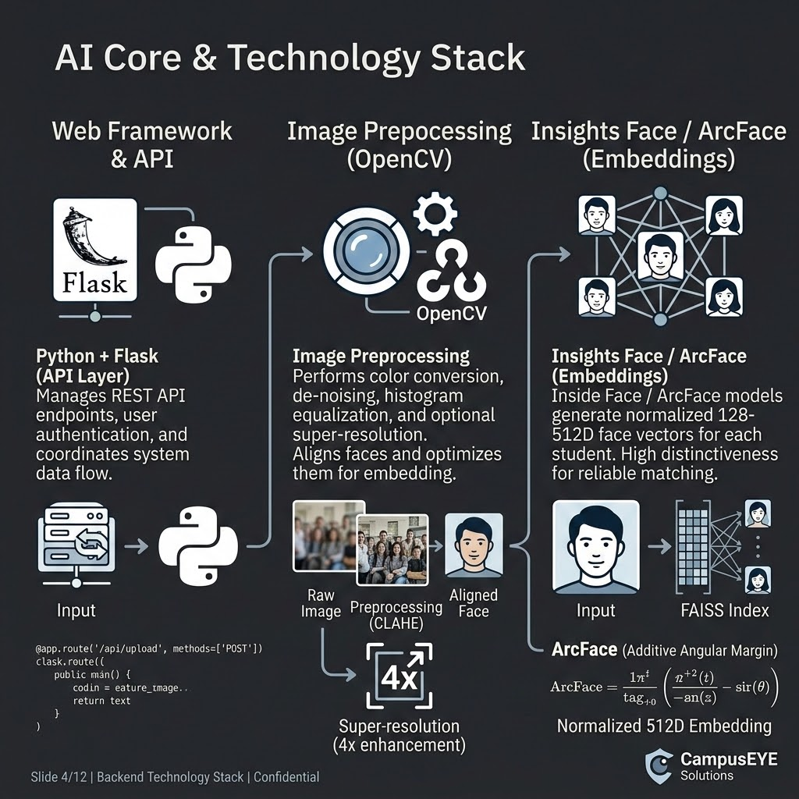
AI Recognition Pipeline — Step-by-step
Input Image
Preprocessing (OpenCV)
Raw classroom photo from teacher device; may contain multiple students, occlusions, and varied lighting.
Color conversion, de-noising, histogram equalization, and optional CLAHE for low-light scenes.
Face Detection (Retina Face)
Face Alignment
Locate all face bounding boxes with landmarks for high recall and landmark precision.
Use detected landmarks to geometrically align each face (eyes/nose) for consistent embedding.
Image Enhancement
Embedding (ArcFace / FaceNet)
Scale, crop, and apply super-resolution or denoise when needed to improve low-quality inputs.
Generate 128–512D normalized face vectors for each detected face.
Matching & Scoring
Attendance Decision
Cosine similarity against registered student embeddings; produce score and confidence.
Threshold-based present/unknown classification; log status and confidence for review.

Slide 4

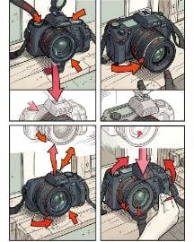


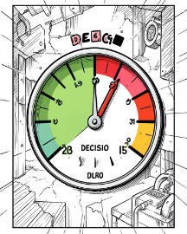

Module Breakdown — Clear, actionable components
Module 1 — Student Registration
Module 2 — Dataset Preparation
Capture Student ID, name, department, and 5–10 face images across angles and lighting for robust enrollment.
Resize, normalize, and augment (flip, crop, color jitter) to expand the enrollment set and reduce bias.
Module 3 — Face Detection
Module 4 — Face Recognition
Retina Face locates faces and landmarks; outputs per-face crops for alignment and downstream processing.
ArcFace/FaceNet produce embeddings; embeddings stored encrypted and linked to student IDs.
Module 5 — Attendance Verification
Module 6 — Dashboard
Compare embeddings with cosine similarity; apply adaptive thresholding and confidence checks to label Present or Unknown.
Faculty view: attendance lists, correction workflow, analytics, and export to LMS.

Slide 5

System Architecture — Components & Data Flow
Teacher device uploads
Attendance Logic
Compute presence and timestamps
Image sent from classroom
Face Recognition
Attendance System Architecture
REST API gateway
Identify student identities
Forwards image to AI Engine
Face Detection
AI Engine
Locate faces in image
Processes image and runs models
Stateless REST API, containerized AI engine (Docker), model-serving microservices, and a transactional DB for attendance records. Option for on-premise or cloud with VPC and strict network controls.

Slide 6
Database Schema — Key tables
Students
Columns
Notes
Attendance
Columns
Notes
Student ID
Name
Primary key
Student ID
Course
Foreign keys
Department
Embedding
Encrypted vector
DateTime
Confidence
Cosine score
Status
PhotoRef
Present/Unknown/Manual
Images
Enroll Date
Storage pointers
Faculty table stores access rights and course mappings. Index embeddings for fast nearest-neighbor search (FAISS or equivalent).

Slide 7

Attendance Processing Algorithm (Operational)
Capture
Detect Faces
Align
Enhance
Key considerations: batch processing for multi-face photos, dynamic thresholding per course/lighting, fallback to manual review when confidence is below cutoff, and audit logs for every decision.

Slide 8



Technology Stack & Deployment
Backend
Python + Flask, OpenCV for preprocessing, Insights Face/Inside Face models (Arc Face) for embeddings.
Data & Search
MySQL for transactional data, FAISS for vector search, encrypted storage for embeddings.
Frontend
React web portal and optional Flutter mobile app for teachers; Dockerized services and CI/CD via GitHub Actions.

Slide 9



Security, Privacy & Compliance
1
Data Protection
Encrypted embeddings (AES-256), TLS for transport, key rotation, and strict access controls.
2
Access Controls
Role-based access, audit trails, and faculty-only correction workflows.
3
Consent & Policy
Operational security: segregated networks for AI model serving, scheduled vulnerability scans, and incident response plan for data events.
Student consent capture during registration and options for on-premise data residency to meet campus policy.

Slide 10


Benefits & Roadmap
Proposed Timeline
Advantages
7-week deployment plan: Week 1 data collection → Weeks 2–3 model dev → Week 4 backend → Week 5 frontend → Week 6 integration → Week 7 testing & deploy.
No RFID cards, multi-face capture, faster roll calls, reduced proxy attendance, analytics-ready, and LMS integration-ready.

